Slide 1
ISS: COMM 256
Conflict Resolution
Module 1: Professionalism
Module 6: Teamwork
Adapted with permission from Aidan Wyatt, CALS Department, 2012

Slide 2
www.kilmanndiagnostics.com
Conflict behaviours are the result of both personal predispositions and the requirements of the situation you are in.

Slide 3
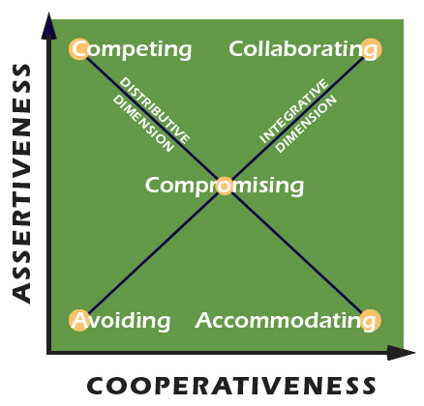
Thomas Kilmann Conflict Mode Instrument
Figure 1: Conflict Model
Source: Canadian Society for Medical Laboratory Science, 2014. Reproduced and used in accordance with SAIT’s Fair Dealing Policy (Schedule A Copyright of External Materials Procedure AC.2.12.1); further distribution may infringe copyright. https://mentalhealth.csmls.org/i-am-an-employee/#crp

Slide 4
www.kilmanndiagnostics.com
accommodate –puts others’ interests first
avoid –fails to resolve issues
collaborate –works to satisfy all interests
compete –puts own self-interests first
compromise – falls in the middle of both scales

Slide 5
Competing
Assertive and uncooperative
Individual pursues own concerns at others’ expense
Win-Lose
Could involve standing up for your rights, defending a position you believe is correct, or simply trying to win.

Slide 6
Collaborating
Assertive and cooperative
Individual works with others to find mutually satisfying solution
Win-Win
Could involve exploring a disagreement to see both points of view, or finding a creative solution to a problem.

Slide 7
Compromising
Intermediate
Gives up more than competing and less than accommodating
Addresses issue more directly than avoiding but not as in-depth as collaborating
Win/lose-Win/lose
Could involve splitting the difference, exchanging concessions, seeking a middle ground.

Slide 8
Avoiding
Unassertive and uncooperative
Conflict is not addressed
Neither win nor lose
Could involve sidestepping an issue, postponing a discussion, or withdrawing from a difficult or threatening situation.

Slide 9
Accommodating
Unassertive and cooperative
Individual neglects own concerns to satisfy the other(s)
Lose-Win
Could involve obeying orders or yielding to another’s point of view.

Slide 10
References
Thomas-Kilmann Conflict Mode Instrument: Profile and Interpretive Report. Retrieved from http://www.kilmanndiagnostics.com/overview-thomas-kilmann-conflict-mode-instrument-tki

